Slide 1
Lecture 6
Lipschitz theorems

Slide 2
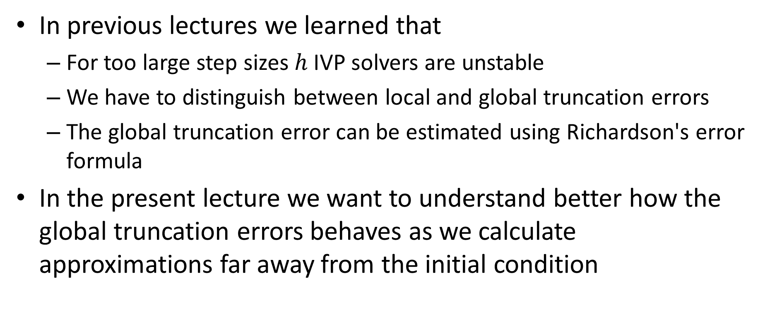
Introduction
In previous lectures we learned that
For too large step sizes $h$ IVP solvers are unstable
We have to distinguish between local and global truncation errors
The global truncation error can be estimated using Richardson's error formula
In the present lecture we want to understand better how the global truncation errors behaves as we calculate approximations far away from the initial condition
Notes:
In previous lectures we learned that
For too large step sizes $h$ IVP solvers are unstable
We have to distinguish between local and global truncation errors
The global truncation error can be estimated using Richardson's error formula
In the present lecture we want to understand better how the global truncation errors behaves as we calculate approximations far away from the initial condition

Slide 3
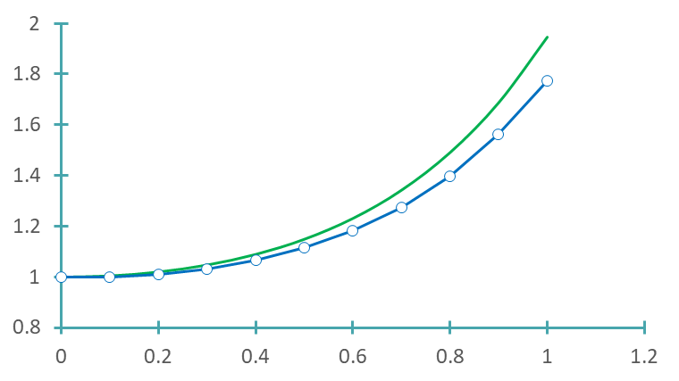

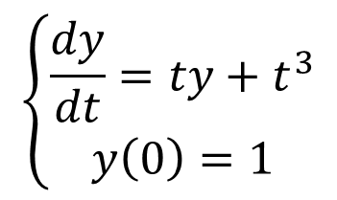
Introduction
$$y\left(t\right)={3e}^{t^{2}/2}−t^{2}−2$$
$$\left\{\begin{aligned}\frac{dy}{dt}=ty+t^{3} \\ y\left(0\right)=1\end{aligned}\right.$$
Notes:
Let us return to an initial value problem we solved in previous lectures
The problem is to solve $\frac{dy}{dt}=ty+t^{3}$ with the initial condition y(0)=1
The exact solution is $y\left(t\right)={3e}^{t^{2}/2}−t^{2}−2$
The graph displays as well the numerical solution produced by Euler’s method with a step size of 0.1
If we compare the numerical solution and the exact solution we can conclude that the further away we are from the initial condition, the more the two quantities differ.
The grow seems to follow an exponential law.
This is not an accident as we will learn in this lecture more about it

Slide 4

Lipschitz Function
Definition
A function $f(t,y)$ satisfies the Lipschitz condition in the variable $t$ on the rectangle $S=\left[t_{o},t_{f}\right]×\left[y_{1},y_{2}\right]$ if there exists a constant $L$ (called Lipschitz constant) satisfying:
$$\left|f\left(t,y_{1}\right)−f\left(t,y_{2}\right)\right|≤L\left|y_{1}−y_{2}\right|$$
for each $t$ in $\left[t_{o},t_{f}\right]$.
Notes:
Before being able to formulate the theorem that will explain us how the numerical solution differs from the exact solution as we calculate approximations further away from the initial condition, we havt o introduce a definition
The definition reads:
A function $f(t,y)$ satisfies the Lipschitz condition in the variable $t$ on the rectangle $S=\left[t_{o},t_{f}\right]×\left[y_{1},y_{2}\right]$ if there exists a constant $L$ (called Lipschitz constant) satisfying:
$$\left|f\left(t,y_{1}\right)−f\left(t,y_{2}\right)\right|≤L\left|y_{1}−y_{2}\right|$$
for each $t$ in $\left[t_{o},t_{f}\right]$
This definition looks very abstract and far fetched. Let us look to it a little closer

Slide 5
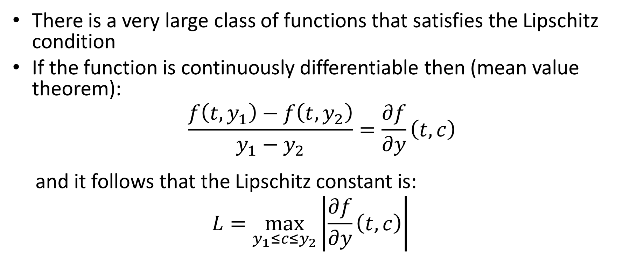
Remarks
There is a very large class of functions that satisfies the Lipschitz condition
If the function is continuously differentiable then (mean value theorem):
$$\frac{f\left(t,y_{1}\right)−f\left(t,y_{2}\right)}{y_{1}−y_{2}}=\frac{∂f}{∂y}\left(t,c\right)$$
and it follows that the Lipschitz constant is:
$$L=\max_{y_{1}≤c≤y_{2}}\left|\frac{∂f}{∂y}\left(t,c\right)\right|$$
Notes:
First let me tell you that there is a very large class of functions that satisfies the Lipschitz condition
For example, consider a function which continuously differentiable.
Using the mean value theorem we can state that
$$\frac{f\left(t,y_{1}\right)−f\left(t,y_{2}\right)}{y_{1}−y_{2}}=\frac{∂f}{∂y}\left(t,c\right)$$
If you multiply this equation on the left and the right by y1-y2 then you get exactly the Lipschitz condition with the Lipschitz constant L being the maximal value of $\frac{∂f}{∂y}\left(t,c\right)$ over the interval y1 to y2
In other words, any function which is continuously differentiable is Lipschitz.
For the purpose of the course of this semester there is no need to be able to calculate the constant L.
It is enough to have a rough understanding what it represents.
In the next slides we will present two important theorems for IVP solvers that hold for Lipschitz functions.

Slide 6

Existence and uniqueness theorem
Theorem
If the function $f(t,y)$ satisfies the Lipschitz condition then the initial value problem
$$\left\{\begin{aligned}\frac{dy}{dt}=f\left(t,y\right) \\ y\left(t_{o}\right)=y_{o}\end{aligned}\right.$$
has a solution and this solution is unique
Notes:
The first theorem reads
If the function $f(t,y)$ satisfies the Lipschitz condition then the initial value problem
$$\left\{\begin{aligned}\frac{dy}{dt}=f\left(t,y\right) \\ y\left(t_{o}\right)=y_{o}\end{aligned}\right.$$
has a solution and this solution is unique
Now this theorem is good news for IVP solvers. It means that we have in fact exactly one solution that we aim to find. That makes things much simpler than if there would be multiple solutions

Slide 7

Lipschitz theorem
Theorem
Consider a function $f(t,y)$ satisfing the Lipschitz condition in the variable $t$ on the rectangle $S=\left[t_{o},t_{f}\right]×\left[y_{1},y_{2}\right].$ If $y(t)$ and $z(t)$ are two solutions of the differential equation
$$\frac{dy}{dt}=f\left(t,y\right)$$
with initial conditions $y\left(t_{o}\right)=y_{o}$ and $z\left(t_{o}\right)=z_{o}$ then
$$\left|y(t)−z(t)\right|≤e^{L\left(t−t_{o}\right)}\left|y_{o}−z_{o}\right|$$
Notes:
The second theorem tells us something about how two solutions of our intial value problem, but with two different initial conditions, evolve
It reads
Consider a function $f(t,y)$ satisfing the Lipschitz condition in the variable $t$ on the rectangle $S=\left[t_{o},t_{f}\right]×\left[y_{1},y_{2}\right].$ If $y(t)$ and $z(t)$ are two solutions of the differential equation
$$\frac{dy}{dt}=f\left(t,y\right)$$
with initial conditions $y\left(t_{o}\right)=y_{o}$ and $z\left(t_{o}\right)=z_{o}$ then
$$\left|y(t)−z(t)\right|≤e^{L\left(t−t_{o}\right)}\left|y_{o}−z_{o}\right|$$

Slide 8










Lipschitz theorem
$$y$$
$$z(t)$$
$$\left|y(t)−z(t)\right|≤e^{L\left(t−t_{o}\right)}\left|y_{o}−z_{o}\right|$$
$$y(t)$$
$$z_{o}$$
$$\left|y_{o}−z_{o}\right|$$
$$y_{o}$$
$$t_{o}$$
$$t$$
$$t$$
Notes:
To understand this theorem best is to consider a figure
We have our initial value problem
We consider two different initial conditions y(to)=yo and z(to)=zo
The two functions y(t) and z(t) are the solution of our two initial value problems
Both function satisfy the same differential equation, but start from two different initial conditions
The difference between the initial conditions is $\left|y_{o}−z_{o}\right|$
What the theorem states is how much will be the difference between the two solitons at the point t.
The theorem says that this difference is smaller or equal than $e^{L\left(t−t_{o}\right)}\left|y_{o}−z_{o}\right|$
Even it represents an upper boundary for the difference, it stills gives a feeling about how this difference grows. It grows exponentially with the difference t-to. The grow is larger the larger the Lipschitz constant L is.

Slide 9

Example
Consider
$$\left\{\begin{aligned}\frac{dy}{dt}=ty+t^{3} \\ y\left(0\right)=y_{o}\end{aligned}\right.$$
Exact solution
$$y\left(t\right)={\left(2+y_{o}\right)e}^{t^{2}/2}−t^{2}−2$$
Notes:
Let us illustrate this theorem with an example
We consider the initial value problem $\frac{dy}{dt}=ty+t^{3}$ with initial condition y(0)=yo
The exact solution is $y\left(t\right)={\left(2+y_{o}\right)e}^{t^{2}/2}−t^{2}−2$
I invite you to verify this by substitution

Slide 10
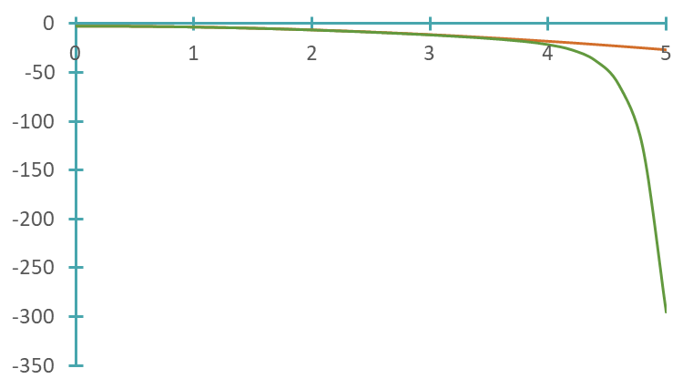

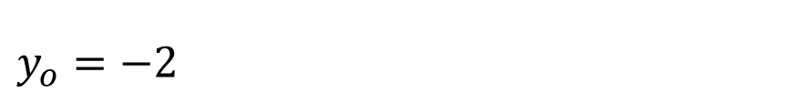


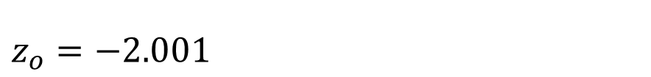

Example
$$y_{o}=−2$$
$$z_{o}=−2.001$$
$y\left(t=5\right)={\left(2−2\right)e}^{5^{2}/2}−5^{2}−2=−2$7
$$z\left(t=5\right)={\left(2−2.001\right)e}^{5^{2}/2}−5^{2}−2=−295.34$$
$$y(t)$$
A small difference in the initial condition results
in a huge difference of the solution
$$z(t)$$
Notes:
Let us now consider two solutions y(t) and z(t)
The first one is with the initial condition y(0)=-2
The second one is with the initial condition z(0)=-2.001
Even the initial conditions are very close to each others, they start to differ dramatically quite soon
For example in t=5 the first solution is at y=-27 whereas the second one is at z=-295.34
The plot of these two solutions shows clearly the difference
The key lesson here is that there exist cases where a small difference in the initial conditions can result in a very large difference in the solutions
Such situations are very challenging for numerical IVP solvers
Indeed, small round-off errors will result in very large errors when calculating the solutions
In that sense such problems are considered to be ill-conditioned
A typical example are the differential equations used to make weather forecast
These equations are very sensitive to the initial conditions explaining why long term weather foracst is not accurate at all

Slide 11
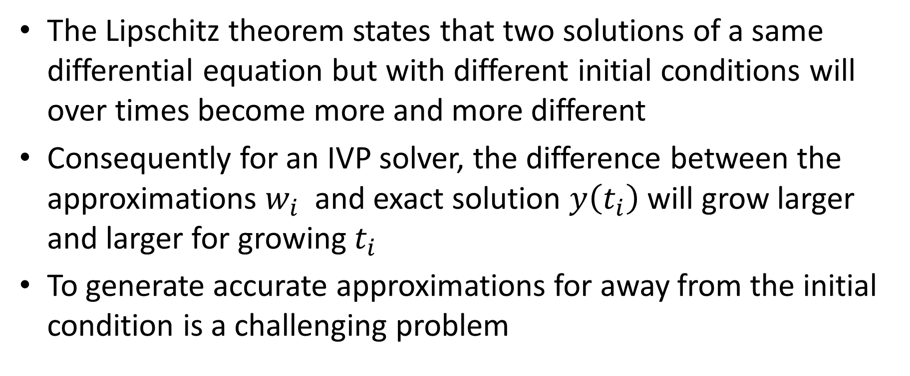
Consequences for IVP solvers
The Lipschitz theorem states that two solutions of a same differential equation but with different initial conditions will over times become more and more different
Consequently for an IVP solver, the difference between the approximations $w_{i}$ and exact solution $y\left(t_{i}\right)$ will grow larger and larger for growing $t_{i}$
To generate accurate approximations for away from the initial condition is a challenging problem
Notes:
There are several consequences from the Lipchitz theorem on how IVP solvers operate
The Lipschitz theorem states that two solutions of a same differential equation but with different initial conditions will over times become more and more different
Consequently for an IVP solver, the difference between the approximations $w_{i}$ and exact solution $y\left(t_{i}\right)$ will grow larger and larger for growing $t_{i}$
In other words, the further away from the initial condition one wants to find an approximation of the solution of the IVP the more accumulated round-off errors will affect the calculations.
But in fact the situation is even more tricky. At each step, the IVP solver will follow a new local solution.
This local solution becomes more and more different from the solution y(t) one desires to approximate
So even without the effect of round-off errors, IVP solvers will inevitably compute approximations with increasing error the further away one is from the initial condition
To generate accurate approximations for away from the initial condition is a challenging problem

Slide 12
Summary
The Lipchitz theorem quantifies how two solutions of a same differential equation with two different initial conditions differ
The difference is becoming larger the further away one is from the initial condition
There exist cases where even a very small difference in the initial condition results in a very large difference in the solutions
Generally it is very challenging for IVP solvers to compute accurate approximations far away from the initial condition

